Slide 1
Methods I Lab Lecture 9

Slide 2
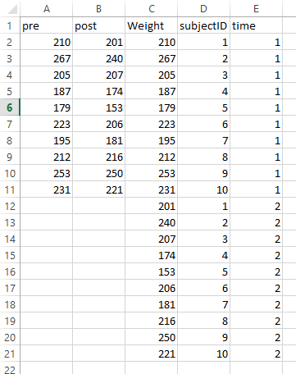
Graphing: Paired data
Don’t forget, ID should never be an axis value
That is, the x-axis nor the y-axis should have anything to do with ID
When given pre/post data, you should transpose the data to go from “wide” to “long”
By doing so, you can Pre/Post be the x-axis and the variable on the y-axis

Slide 3
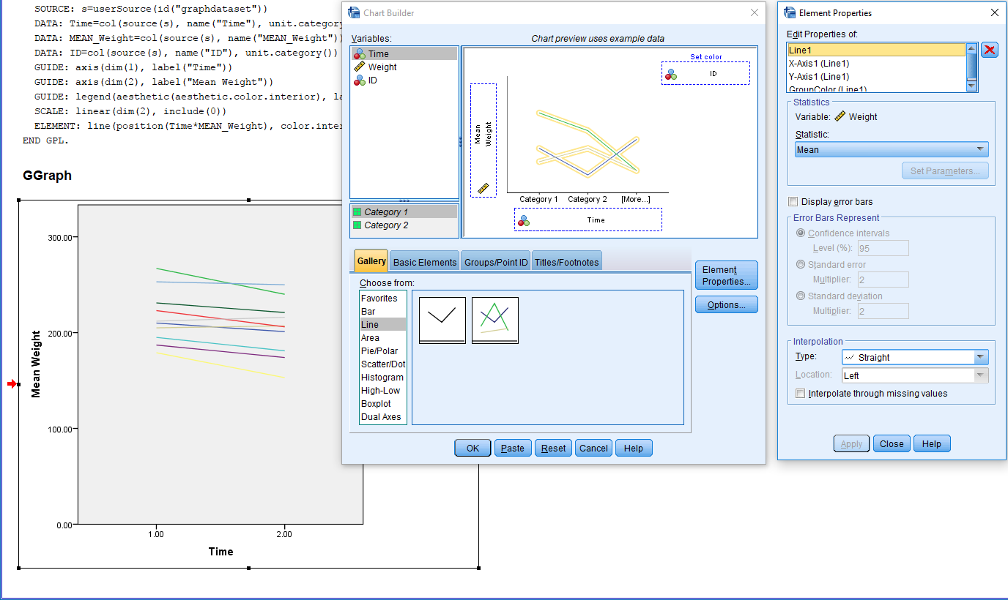
Graphing: Paired data
I found it easiest to use Chart Builder to construct these plots

Slide 4
Graphing: Paired data
This style of visual displays of data does not extend only to pre/post plots or plots involving a dimension of time
It can also be used to show differences in paired data
E.g., IL-12 vs. control

Slide 5
Nonparametric Tests
An SPSS exercise

Slide 6
Nonparametric tests
What’s an example of data that you suspect is not normally distributed?

Slide 7
Nonparametric tests
What’s an example of data that you suspect is not normally distributed?
Income
Age of all-cause mortality
Travel time (to school, work, etc…)
ER visit times
Etc…

Slide 8
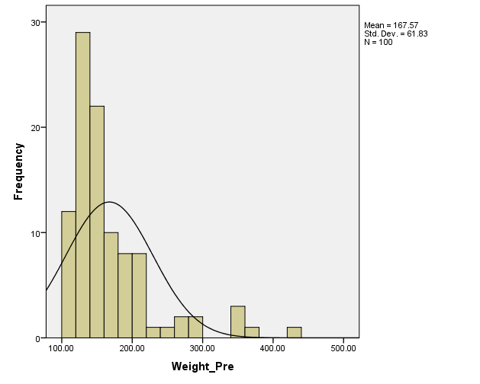
Nonparametric tests
Let’s look at some fictitious weight data…
Please reference the ‘Weight’ dataset
Generated by:
(RV.NORMAL(20,5))*(ABS(RV.NORMAL(0,1))+1) + (ABS(RV.NORMAL(0,1)) + 1)*((RV.NORMAL(3,4))**2)
weight+(((weight **1.2)*.2)/100)

Slide 9
Nonparametric tests
Answer the following…
Was the relative change in income different that .1?
What was the median and average relative change?
Was the relative change in income different for the Haves groups?
What was the median and average relative change for each of the Haves groups?
Was the raw change in income different for the Haves groups?
What was the median and average raw change for each of the Haves groups?

Slide 10
Nonparametric tests
Wilcoxon Signed Rank Test
Compares pairs
Appropriate for pairs where there is a numeric difference between the pairs
The non-parametric analog to the paired t-test
Sign Test
Compares pairs
Appropriate for pairs where you can assign that one is ‘better’ or ‘worse’ (or the same) than the other
Numeric differences between pairs can also be evaluated using the sign test

Slide 11
Nonparametric tests
Wilcoxon Rank Sum Test (Also called Mann-Whitney U test)
Compares two independent samples
Tests if the data are from the same distribution

Slide 12
Nonparametric tests
There are multiple ways to conduct nonparametric tests in SPSS
All of the nonparametric tests can be done using similar options
Analyze
Nonparametric Tests

Slide 13
Nonparametric tests: Exercise
Using your ‘Weight Data’, test:
H₀: Δ = 0
H₁: Δ ≠ 0

Slide 14
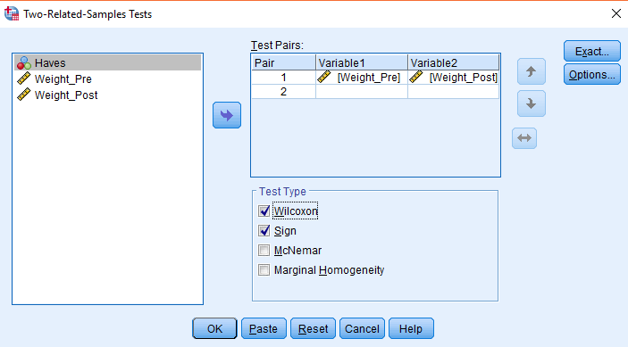
Wilcoxon Signed Rank Test and Sign Test
First way to compute these tests
Steps in SPSS
Analyze
Nonparametrics
Legacy Dialogs
‘2 Related Samples”
Select variables
Select ‘Wilcoxon’ and ‘Sign’

Slide 15
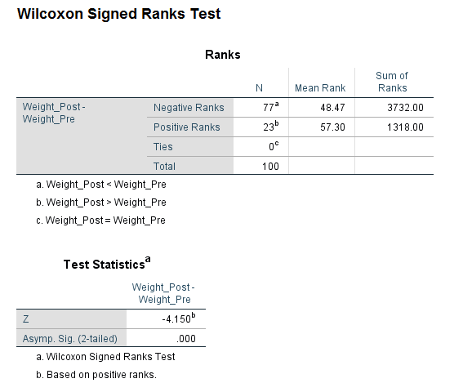
Wilcoxon Signed Rank Test and Sign Test in SPSS- Exercise
Wilcoxon Signed Rank Test Results

Slide 16
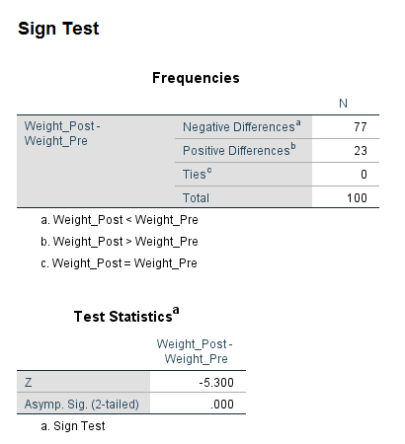
Wilcoxon Signed Rank Test and Sign Test
Sign Test Results

Slide 17
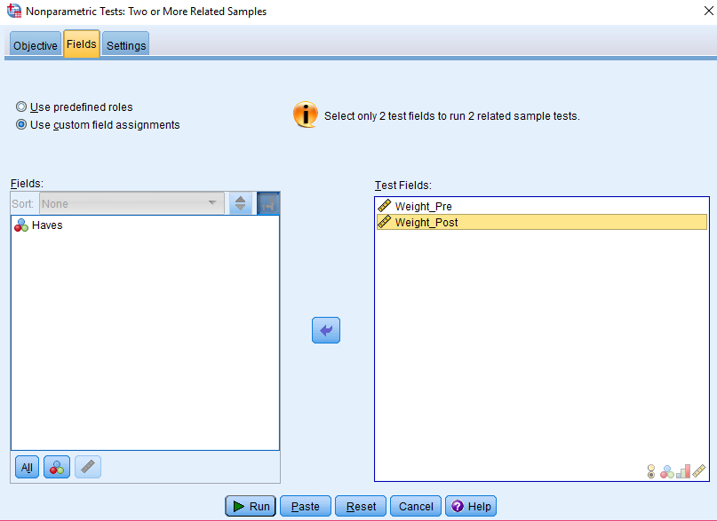
Wilcoxon Signed Rank Test and Sign Test
Analyze
Nonparametrics
Related Samples
Select ‘Customize Analysis’
Select ‘Fields’
Select the pre and post variables
Select ‘Settings’
Select ‘Customize Tests’
‘Wilcoxin matched-pair signed rank (2 samples)’ and ‘Sign Test (2 samples)’

Slide 18
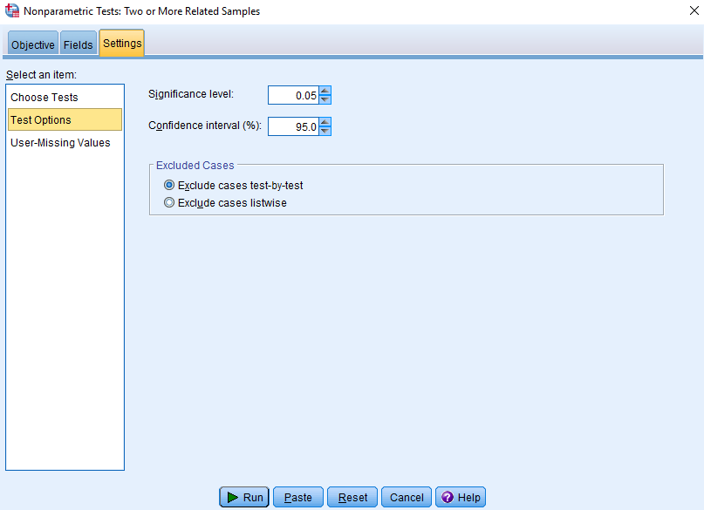
Signed Rank Test in SPSS
There are other options
for the second way
‘Test Options’ allows you to
change the significance level
and confidence interval

Slide 19
Wilcoxon Rank Sum Test
Using the Tumor data, use the Wilcoxon Rank Sum test to test if
H₀: F₁ = F₂
H₁: F₁ ≠ F₂
Let F1 and F2 represent the CDFs in two populations
Tumor data, sample size of 15:
Group 0: No treatment for tumor
Group 1: Pmel treatment for tumor

Slide 20
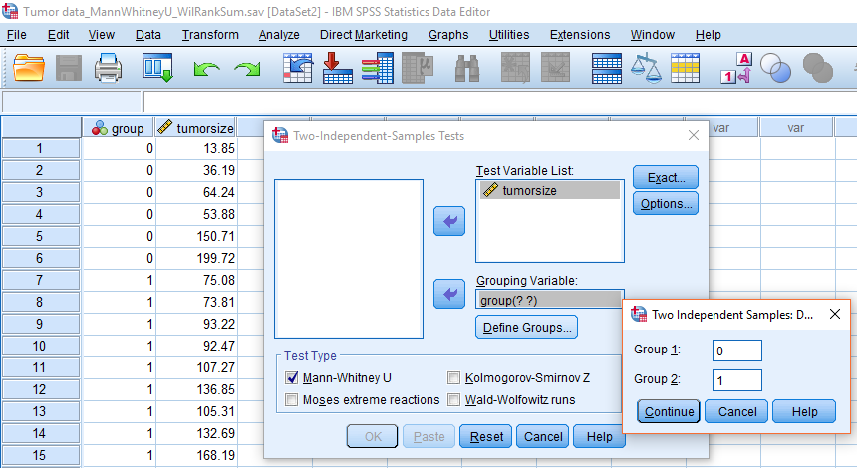
Wilcoxon Rank Sum Test
Analyze
Nonparametrics
Legacy Dialogs -> Select variable and grouping variable
‘Define Groups’
Enter 0 for Group 1
Enter 1 for Group 2
Select ‘Mann-Whitney U’

Slide 21
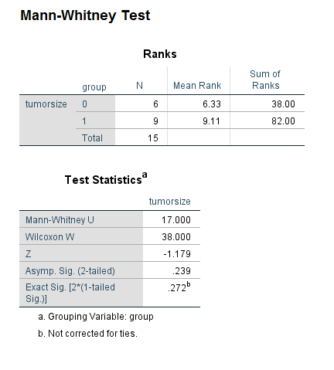
Wilcoxon Rank Sum Test
Wilcoxon Rank Sum Test Results

Slide 22
Wilcoxon Rank Sum Test
Second way to compute Wilcoxon Rank Sum Test
Analyze
Nonparametrics
Independent Samples
‘Customize Analysis’
Select ‘Fields’
Select testing and grouping variables
‘Settings’
‘Customize Tests’
Select ‘Mann-Whitney U (2 samples)

